Slide 1
Exchange User Group Meetup Q1 2023 {Hybrid Edition}
23. Februar 2023

Slide 2

Sponsor

Slide 3
Meetup Q2 2022
MAPI Permissions PowerShell Modul - Andres Bohren
Exchange Online RBAC for Applications (Preview) - Andres Bohren
Exchange Q & A
Die Talks werden aufgezeichnet. The sessions will be recorded. https://go.granikos.eu/EXUSG-Recs

Slide 4
MAPI Permissions PowerShell Modul
Andres Bohren

Slide 5


Slide 6
Exchange Online RBAC for Applications (Preview)
Andres Bohren

Slide 8
Exchange Q & A

Slide 9
Exchange Q & A
February 2023 Exchange Server Security Updates
Exchange Server 2013 End of Support – 11. April 2023
New opt-in endpoint for POP3/IMAP4 clients that need legacy TLS

Slide 10
Exchange User Group

Slide 11
Exchange User Group – On-Tour
Exchange User Group neu gedacht
Lokale Meetup-Treffen mit Hybrid
Termine 2023 (Planung)
11. Mai
24. August
9. November

Slide 12
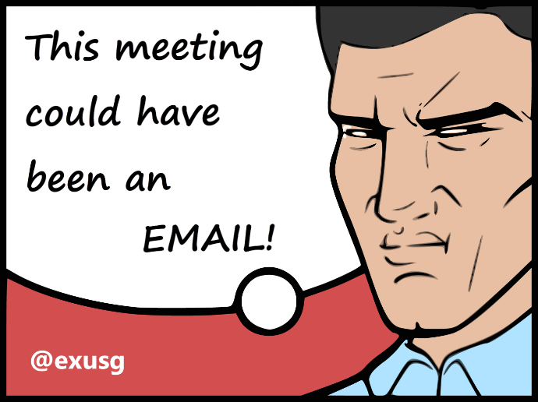
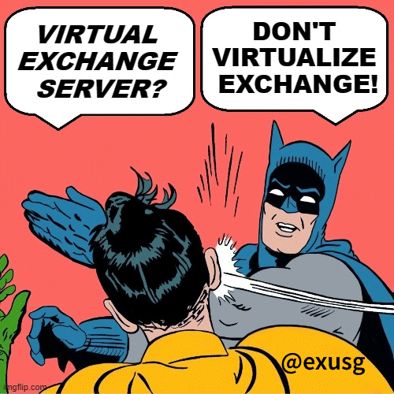

Exchange User Group
Organisatorisches
Exchange User Group Team
Registrierung → Link auf Homepage
Themenvorschläge
https://go.granikos.eu/EXUSG-Themen
Community Sticker
https://go.granikos.eu/CommunitySticker
EXUSG Mugs
https://go.granikos.eu/EXUSGMug

Slide 13

Exchange User Group
Organisatorisches
Nächster Termin 11. Mai 2023
Homepage https://exusg.de
Twitter @exusg
Recordings https://go.granikos.eu/EXUSG-Recs
Räumlichkeiten gesucht!

